Slide 1
The Data Dig
Group 32
Anaye Abernathy
Camille Wong
Elian Fernandez
Justin Pudiquet

Slide 2


Dataset and Playbook
DATASET
Playbook
AWS S3 HoneyBucket Logs
AWS Incident Response Playbook: Data Access
Amazon Web Service (AWS)
Simple Storage Service (S3)
Honeypot + Bucket: HoneyBucket
Gather Evidence
Contain/Eradicate
Recover
Post-Incident

Slide 3
Splunk Analysis

Slide 4
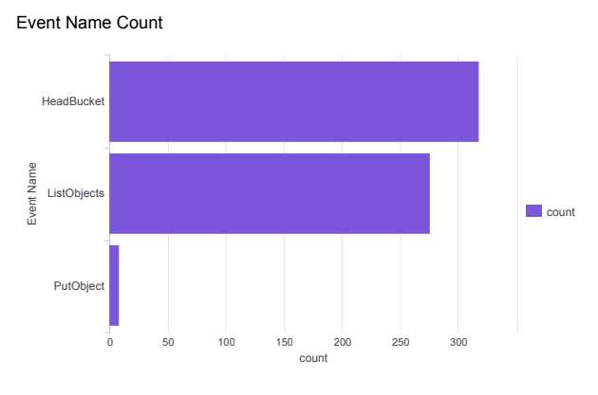
Splunk Analysis: Event Name Count
HIGH COUNT!!!!
HeadBucket Operation
Check if bucket exists and if requester has permission to access it.
ListObject API Call
Lists all the objects within a bucket

Slide 5
ANONYMOUS_PRINCIPLE
POSSIBLE THREAT ACTOR: USER ID: ANONYMOUS_PRINCIPLE

Slide 6
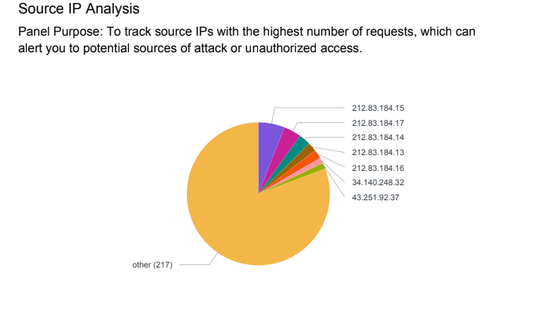
Splunk Analysis: Source IP Analysis

Slide 7
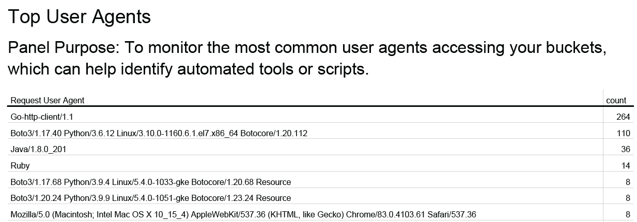
Splunk Analysis: Top User Agents
ANONYMOUS_PRINCIPLE Activity:
Go-http-client/1.1 = Go Lang Automated Scripts
Boto3 = Python script used to create, configure, and manage AWS services

Slide 8
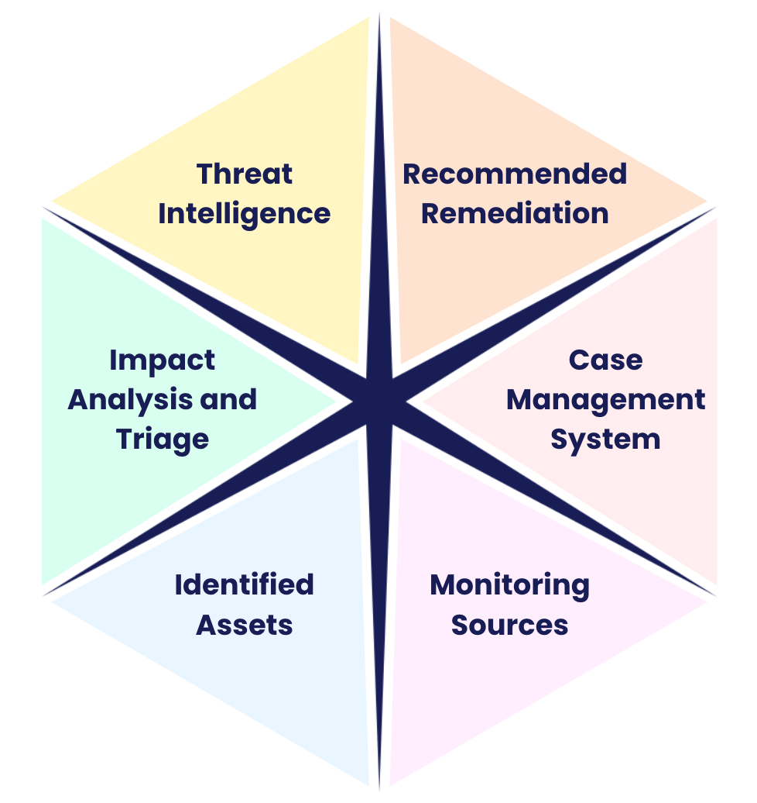
Key Aspects
Overview

Slide 9
01
04
Monitoring Sources
Threat Intelligence
02
04
Identified Assets
Recommended Remediation
03
06
Impact Analysis and Triage
Case Management System

Slide 10
Monitoring Sources
How it relates to our project: The monitoring sources we used is the AWS S3 Honey Bucket Logs.
Example(s):These Network Logs were fed into Splunk in a .csv file format that allowed us to sift through the data in a formatted fashion.

Slide 11
Identified Assets
How it relates to our project:
This relates to our project because it simulates what an attack would look like on an actual AWS S3 Bucket, this gives us an upper hand as we are able to track an adversary’s every move without actually being compromised.
Example(s):
In our project we used data collected from a honeypot that was set up to look like an actual AWS S3 Bucket that allowed us to identify potential or even current threats and how they would go about accessing the decoy data. Our most notable adversary used the API call “ListObjects” in an effort to retrieve the data from the S3 bucket, also most notably the adversaries with the most significant activity in the bucket operated under the User ID: ANONYMOUS_PRINCIPLE.

Slide 12
Impact Analysis and Triage
How it relates to our project:
The AWS Simple Storage Service (S3) bucket is an object storage that allows customers to store all types of data like files, images, and backups. Since this was a HoneyBucket (decoy), theoretically there is no sensitive information. Therefore, the severity of the incident is generally low, but examination of the incident allows for preparations for response efforts.
Example(s):
During routine monitoring, an alert triggers due to multiple ‘ListObjects’ and ‘HeadBucket’ operations from unrecognized IPs on the ‘microsoft-devtest’ S3 bucket. The SOC team immediately analyzed access logs and noticed several uses of the ‘Go-http-client/1.1’ user agent, indicating potential automated scripts.

Slide 13
Threat Intelligence
How it relates to our project:
Using Splunk, this relates to our project because there is a clear common pattern to the threat actors actions within the logs. There is also a clear understanding that these certain actions are linked to unauthorized access within the AWS Bucket.
Example(s):
TTPs - There is a high number of automated scripts (Go and Python scripts) with the unauthorized User ID: ANONYMOUS_PRINCIPLE likely to scan and enumerate bucket contents.
IOCs - Notably suspicious IPs like 212.83.184.15 frequently associate with unauthorized access attempts. Frequent and unauthenticated requests using the ‘HeadBucket’ and ‘ListObjects’ APIs. Consistent use of specific request parameters request that indicate scanning or probing activities.

Slide 14
Recommended Remediation
How it relates to our project:
The recommended remediation towards advanced scans targeting S3 buckets, is to implement comprehensive access controls and frequently restrict permissions to only authenticated users, along with conducting thorough audits of access control lists.
Example(s):
An immediate review of all S3 bucket policies can be conducted to identify and correct any permissions that allowed public or anonymous access.
Create new alerts to notify security teams whenever a ‘ListObject’ or ‘HeadBucket’ operation is performed by unusual IP addresses or unusual times.

Slide 15
Case Management System
How it relates to our project: This was the most important part of our investigation because it was the main reason for having a honeypot and that reason being finding current or potential adversaries.
In the next slide is our greatest IOCs (although every Ip address could be logged as a potential threat because this is a Honey pot) we chose to go with the IPs listed in the next slide.
The two outlier months with the most alerts were January and February of 2022
In those two months, 1 IP address amassed 11 alerts however upon further inspection we were able to denote that there was other IPs that looked very similar and those are the ones we made our IOCs.

Slide 16
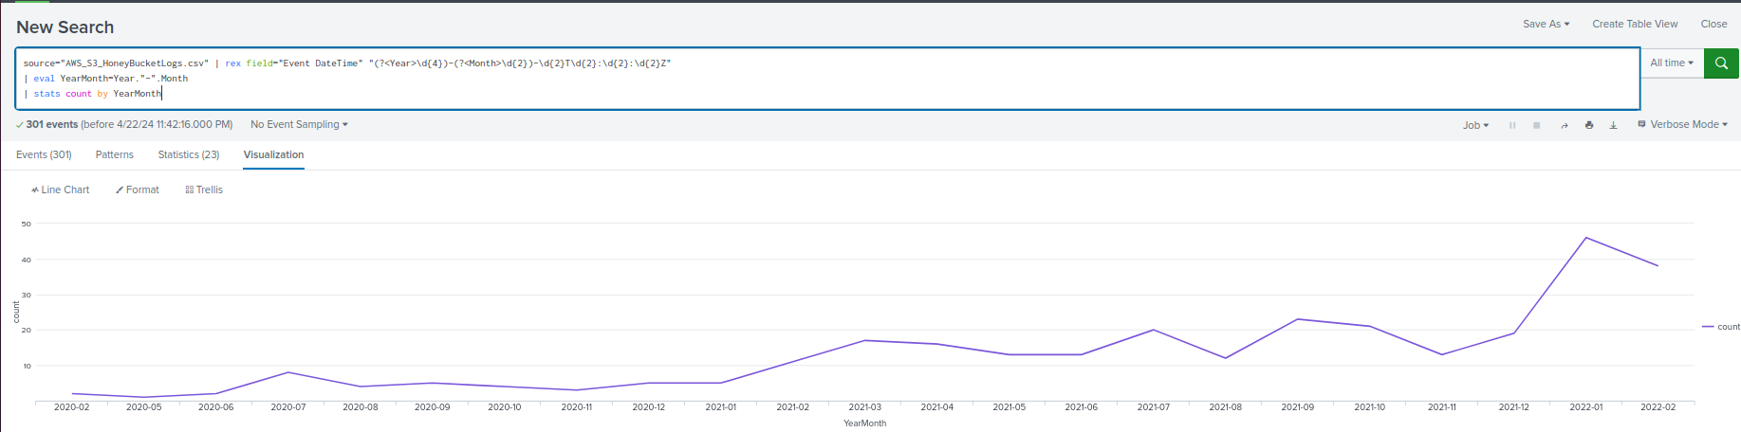
Case Management System (con.)

Slide 17
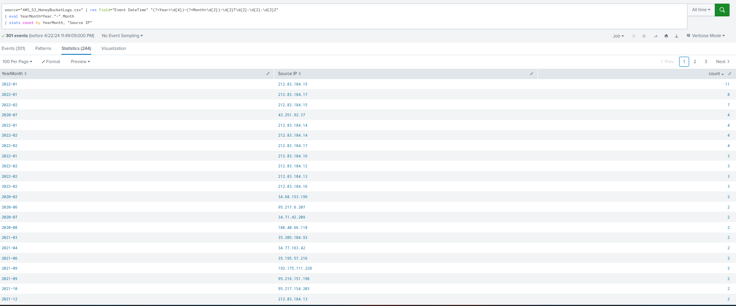
Case Management System (con.)

Slide 18
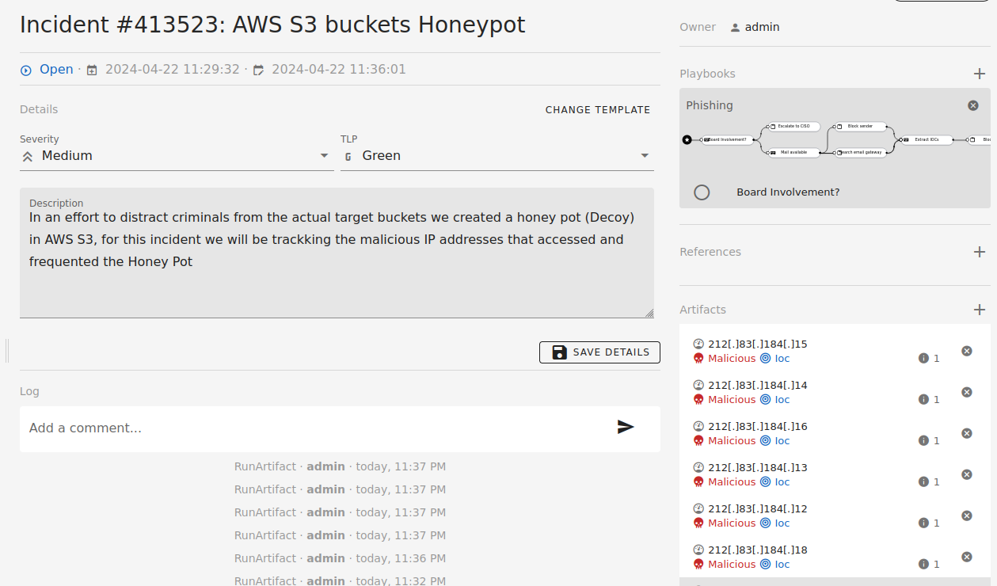
Case Management System (con.)
Examples:

Slide 19
Thank you

